Slide 1

UNSOLVED MYSTERIES IN THE WORLD
Presented by
THIRUVENI B
2320446

Slide 2

What is Mystery ?
A mystery is simply an unsolved question and the attempt to answer it. In literature, this mystery is often a crime, but anything unexplainable can inspire a great mystery novel.
Like all genre fiction, Mystery follows a formula, one that readers expect.

Slide 3
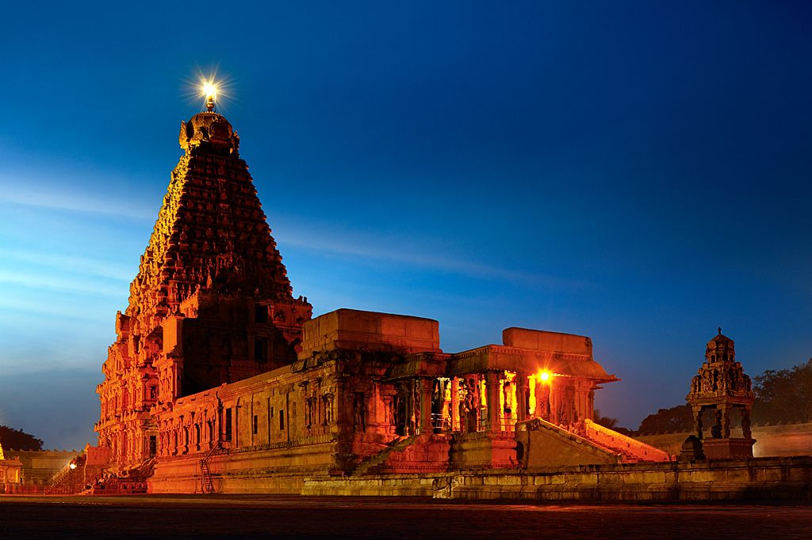
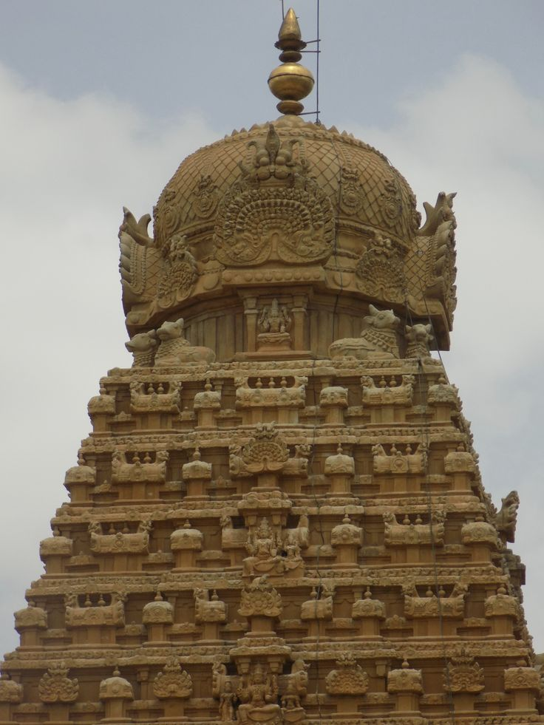
STRANGE FACTS OF BRIHADEESWARAR TEMPLE
Shadow of the temple does not fall on ground in noon.
No binding materials are used.
the Vimana's main stone weighed 235 lbs. Even today, it is a wonder how humanity managed to build this enormous dome all the way to the top without using contemporary technology.

Slide 4
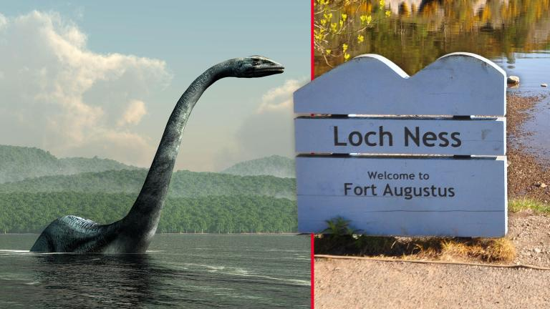
LOCH NESS MONSTER
The Loch Ness Monster, affectionately known as ‘Nessie’, is a captivating mystery.
Said to inhabit the deep, dark waters of Loch Ness in the Scottish Highlands, this enigmatic creature has been a source of fascination, speculation, and debate for generations.
The sheer size of Loch Ness, which extends over 23 miles, is over 200 meters deep in places

Slide 5
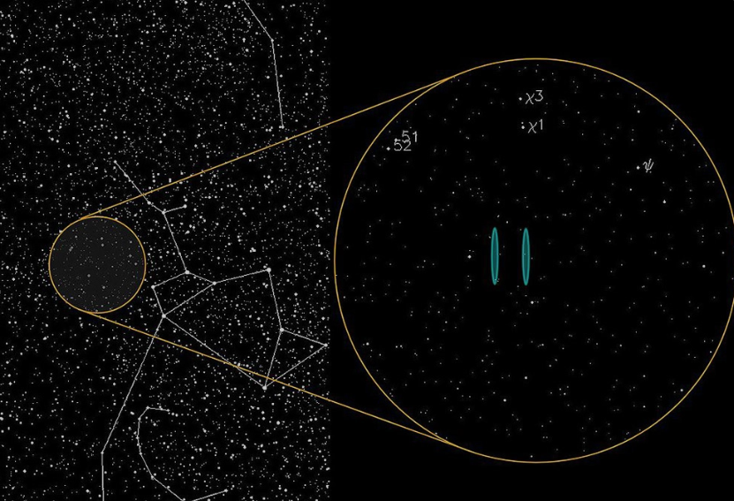
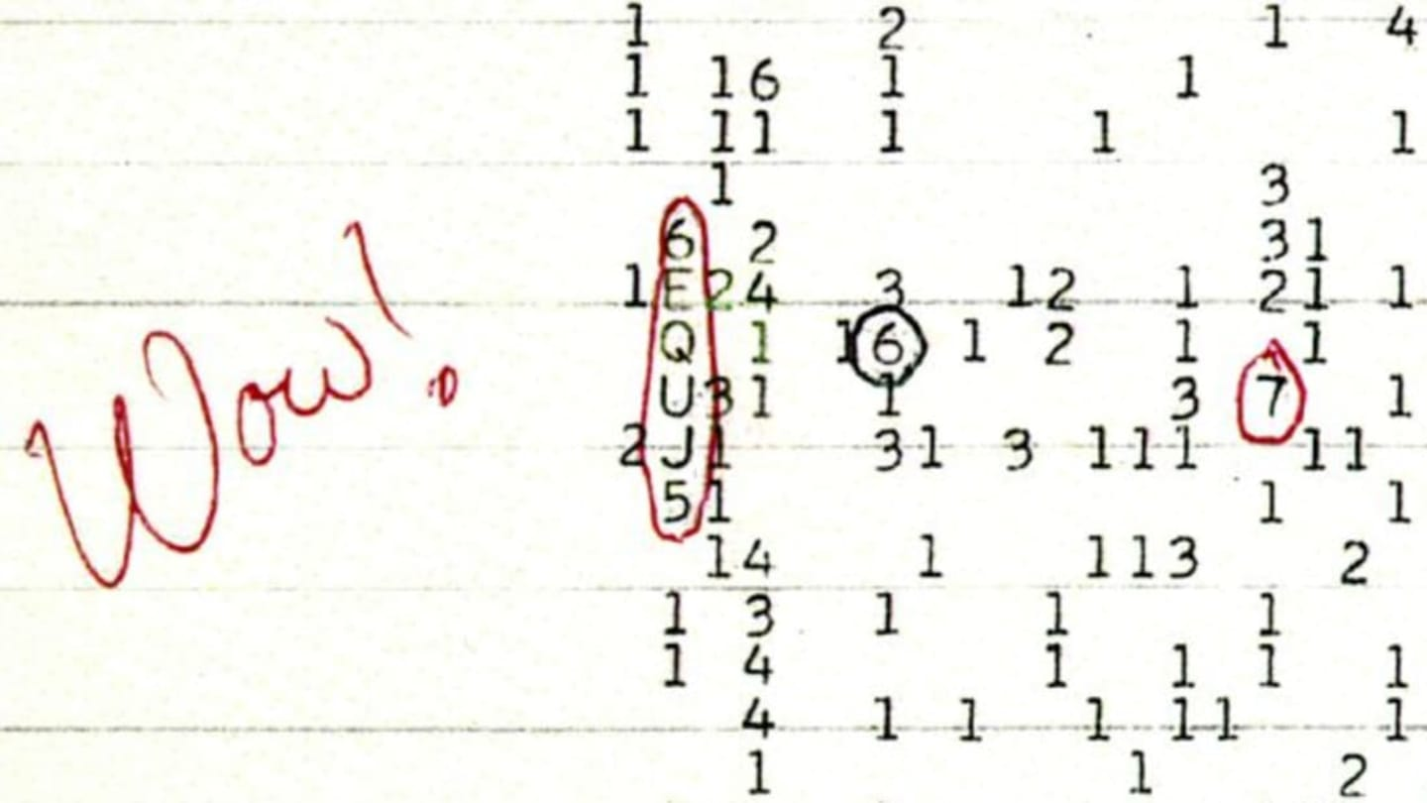
WOW SIGNAL
The Wow! Signal, detected in August 1977 by scientists at Ohio State University’s Big Ear radio telescope, remains an enduring enigma.
Lasting 72 seconds, it bore the cryptic code “6EQUJ5.” The signal’s intensity, equivalent to 30 times the background noise of space, sparked astonishment.
The Wow! Signal, detected in August 1977 by scientists at Ohio State University’s Big Ear radio telescope, remains an enduring enigma. Lasting 72 seconds, it bore the cryptic code “6EQUJ5.”
The signal’s intensity, equivalent to 30 times the background noise of space, sparked astonishment.

Slide 6
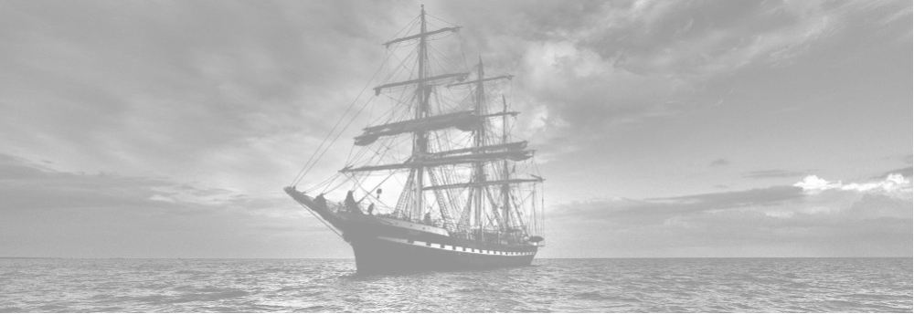
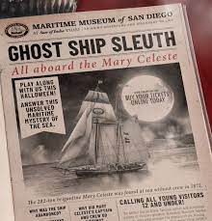
MARY CELESTE
The Mary Celeste, an American brigantine, was discovered abandoned on December 5, 1872, approximately 400 nautical miles (740 km) from the Azores, Portugal.
The ship, originally named the Amazon, had encountered various mishaps since its launch in 1861.
After being sold to American Richard W. Haines, it was renamed the Mary Celeste. On November 7, 1872, the ship set sail from New York City, carrying over 1,700 barrels of alcohol destined for Genoa, Italy.
However, when the British brig Dei Gratia spotted the Mary Celeste, it was deserted. The crew had vanished, leaving behind undisturbed cargo and belongings.

Slide 7
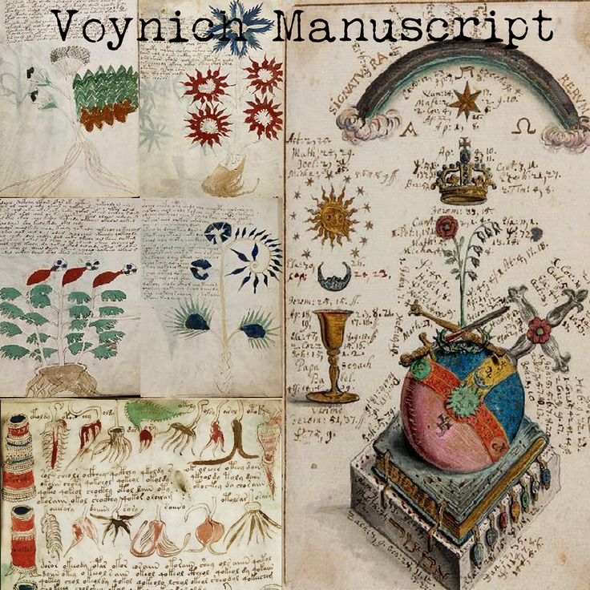
VOYNICH MANUSCRIPT
Many call the fifteenth-century codex, commonly known as the “Voynich Manuscript,” the world's most mysterious book.
Written in an unknown script by an unknown author, the manuscript has no clearer purpose now than when it was rediscovered in 1912 by rare books dealer Wilfrid Voynich.

Slide 8
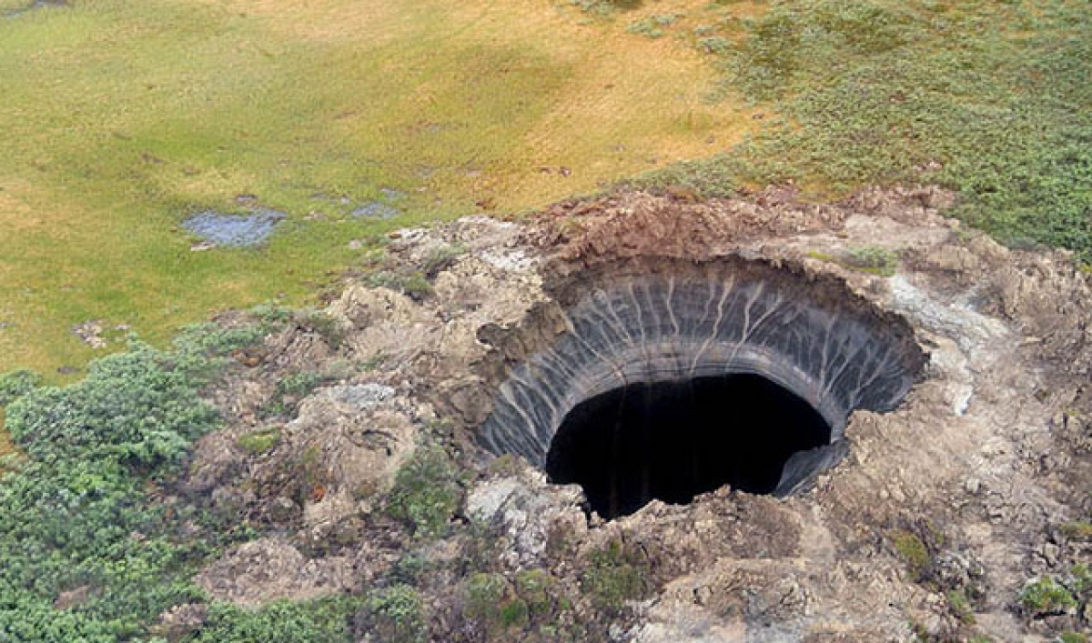
SIBERIAN SINKHOLE MYSTERY
In the vast Siberian tundra, a 20-meter-wide and 30-meter-deep sinkhole baffles scientists.
Discovered accidentally by a Russian TV crew, theories range from methane gas explosions to extraterrestrial involvement
Large craters in sibesian tundra,particularly the Yamal peninsula.

Slide 9
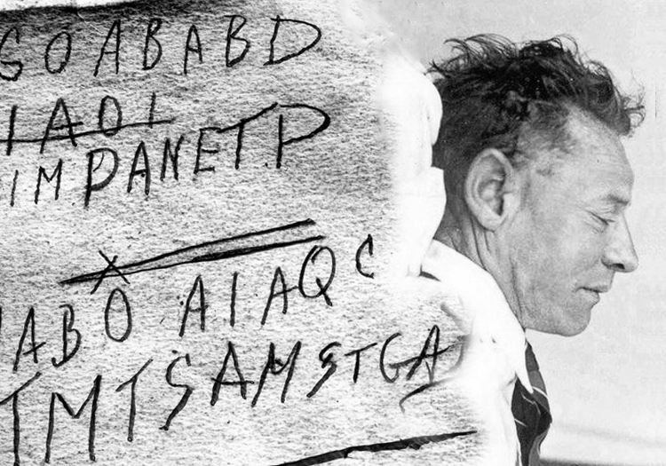
TAMAM SHUD CASES
The Tamam Shud case, also known as the Mystery of the Somerton Man, is an unsolved case of an unidentified man found dead in 1948 on the Somerton Park beach, just south of Adelaide, South Australia, Australia.
The case abounds in clues, threads, theories, rumours and artefacts.
In the 73 years since the man's body was found on Adelaide's Somerton beach, that mystery has only deepened.

Slide 10

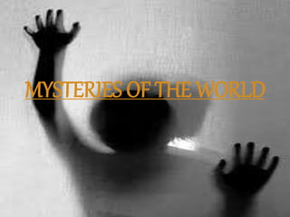
Mystery will continue to beckon us.......

